Slide 1
Machine Learning
Machine Learning Introduction to Machine Learning by Kumar Anurupam is licensed under a Creative Commons Attribution-4.0 International License.
Artificial Neural Networks – Learning Rules, Gradient Descent
CS 3104 Fall 2019
Lecture Slides by Kumar Anurupam

Slide 2
Learning Objectives
After completion of today’s session you will be able to:
Explain the concept of Gradient Descent
Illustrate the Delta Rule and Hebb’s Rule of perceptron learning

Slide 3

Gradient Descent - Intuition

Slide 4
Gradient Descent
Gradient descent is an optimization algorithm used to minimize some function by iteratively moving in the direction of steepest descent as defined by the negative of the gradient.
In machine learning, we use gradient descent to update the parameters of our model. Parameters refer to coefficients in Linear Regression and weights in neural networks.

Slide 5
Explanation

Slide 6
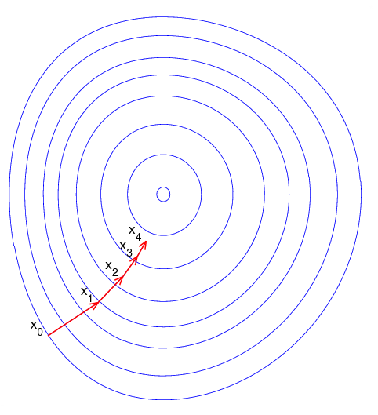
Gradient Descent 2D representation

Slide 7
Rules of learning in a Perceptron – contd…
The Delta Rule:
It is a supervised learning rule and also called as Error correction learning.
Developed by Widrow and Hoff, the delta rule.
In machine learning, the Delta rule is a gradient descent learning rule for updating the weights of the inputs to artificial neurons in a single-layer neural network.
For a neuron j with activation function g(x), the delta rule for j’s i^{th} weight w_{ji} is given as: Δw_{ji} = η (t-o) g’(h_{j}) x_{i}
Where:
h_{j} = ∑ x_{i}w_{ji}
o_{j} = g(h_{j})
g’(h_{j}) = derivative of the activation function used
Update each weight by w_{i} = w_{i} + Δw_{i}
The Δw_{ji} is calculated by using Gradient Descent on the error.

Slide 8
Delta Rule derivation

Slide 9
Rules of learning in a Perceptron – contd…
The Hebbian Rule:
The Hebbian rule was the first learning rule. In 1949 Donald Hebb developed it as learning algorithm of the unsupervised (desired responses of neurons are not used) neural network.
It assumes that
If two neighbor neurons activated and deactivated at the same time. Then the weight connecting these neurons should increase.
For neurons operating in the opposite phase, the weight between them should decrease.
If there is no signal correlation, the weight should not change.
At the start, values of all weights are set to zero.
Update each weight according to this rule:
w_{i} = w_{i} + Δw_{i}
Where: rule for j’s i^{th} weight w_{ji} is given as
Δw_{ji} = η out_{j} in_{i =} η x_{j} x_{i}

Slide 10
References
[1] https://ml-cheatsheet.readthedocs.io/en/latest/gradient_descent.html
[2] https://en.wikipedia.org/wiki/Delta_rule
[3] https://data-flair.training/blogs/learning-rules-in-neural-network/

Slide 11
Thanks

